Slide 1
8. Model Evaluation

Slide 2
Model Evaluation
Model Evaluation is an integral part of the model development process.
It helps to find the best model that represents our data and how well the chosen model will work in the future.
Evaluating model performance with the data used for training is not acceptable in data science because it can easily generate overoptimistic and overfitted models.
There are two methods of evaluating models in data science:
Hold-Out
Cross-Validation.
To avoid overfitting, both methods use a test set (not seen by the model) to evaluate model performance.

Slide 3
Hold-Out
In this method, the mostly large dataset is randomly divided to three subsets:
Training set is a subset of the dataset used to build predictive models.
Validation set is a subset of the dataset used to assess the performance of model built in the training phase. It provides a test platform for fine tuning model's parameters and selecting the best-performing model. Not all modeling algorithms need a validation set.
Test set or unseen examples is a subset of the dataset to assess the likely future performance of a model. If a model fit to the training set much better than it fits the test set, overfitting is probably the cause.

Slide 4
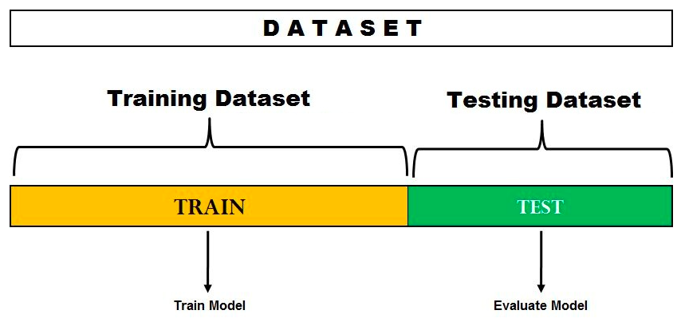



Hold-out

Slide 5
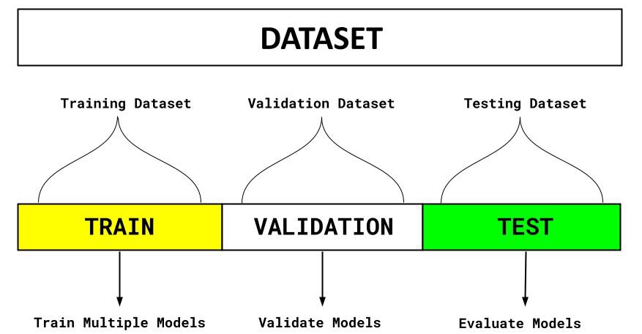








Hold-out
Parameters tuning like k in kNN

Slide 6
Cross-Validation
When only a limited amount of data is available, to achieve an unbiased estimate of the model performance we use k-fold cross-validation.
In k-fold cross-validation, we divide the data into k subsets of equal size.
We build models k times, each time leaving out one of the subsets from training and use it as the test set. If k equals the sample size, this is called "leave-one-out".

Slide 7
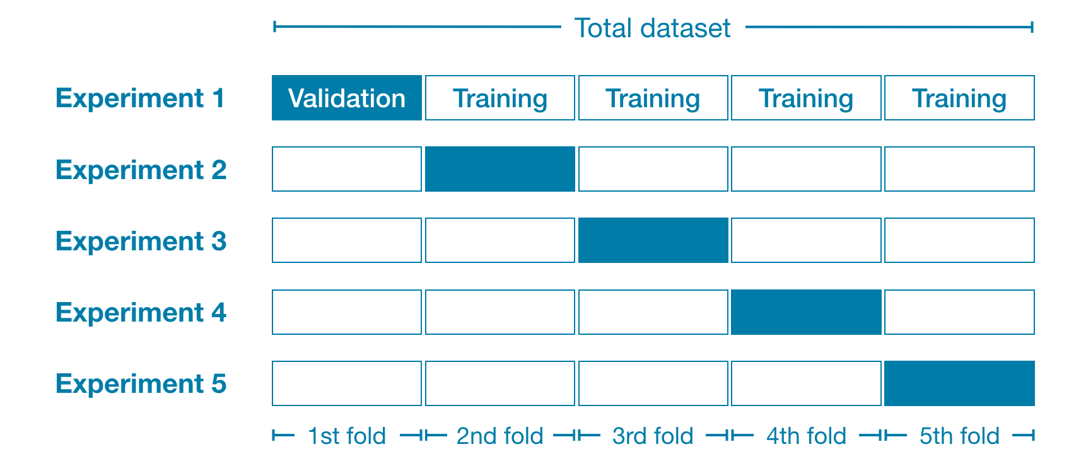





Cross validation: 5-folds CV

Slide 8
Errors
Training errors: Errors committed on the training set
Test errors: Errors committed on the test set
Generalization errors: Expected error of a model over random selection of records from same distribution

Slide 9
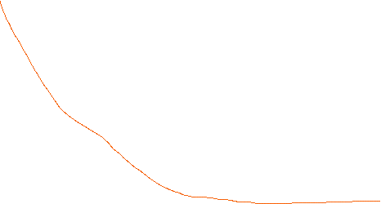
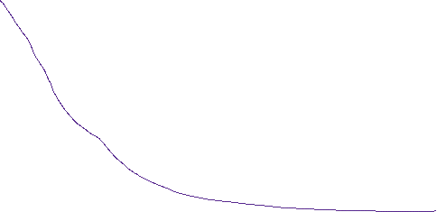

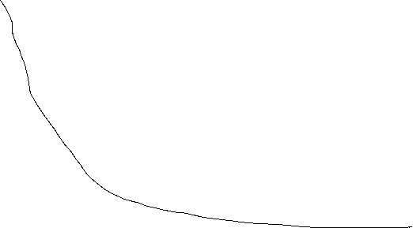

Slide 10
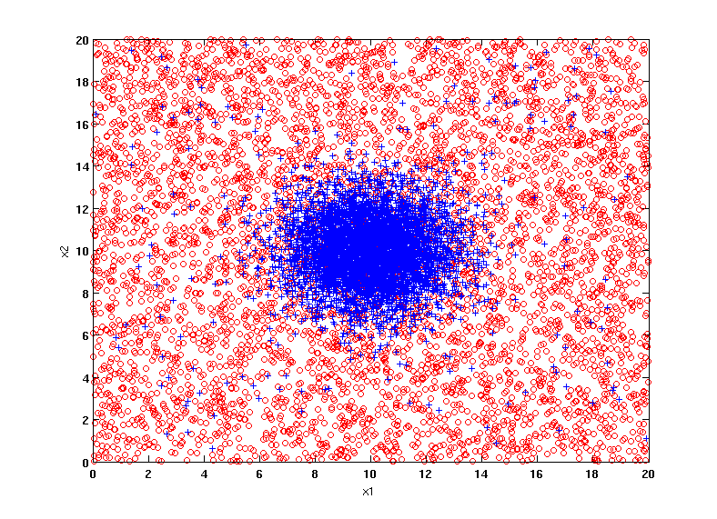
Example Data Set
Two class problem:
+ : 5400 instances
5000 instances generated from a Gaussian centered at (10,10)
400 noisy instances added
o : 5400 instances
Generated from a uniform distribution
10 % of the data used for training and 90% of the data used for testing

Slide 11
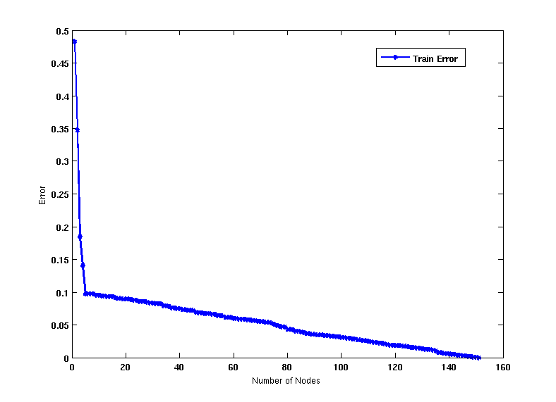
Increasing number of nodes in Decision Trees

Slide 12
Decision Tree with 4 nodes
Decision Tree
Decision boundaries on Training data

Slide 13
Decision Tree with 50 nodes
Decision Tree
Decision Tree
Decision boundaries on Training data

Slide 14
Which tree is better?
Decision Tree with 4 nodes
Which tree is better ?
Decision Tree with 50 nodes

Slide 15
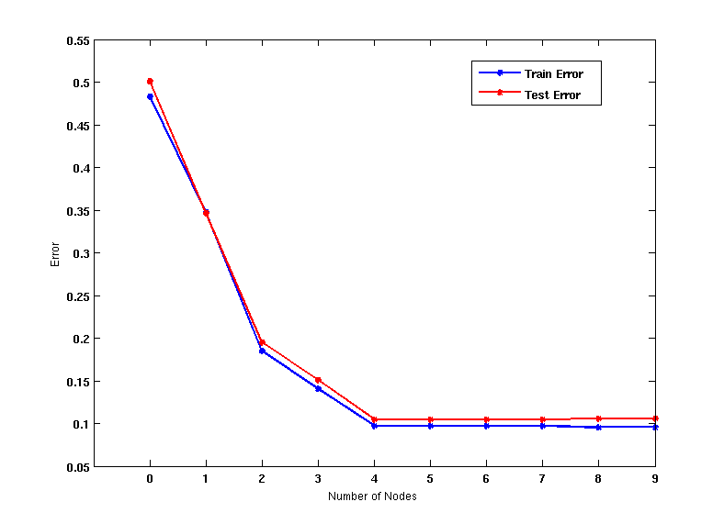
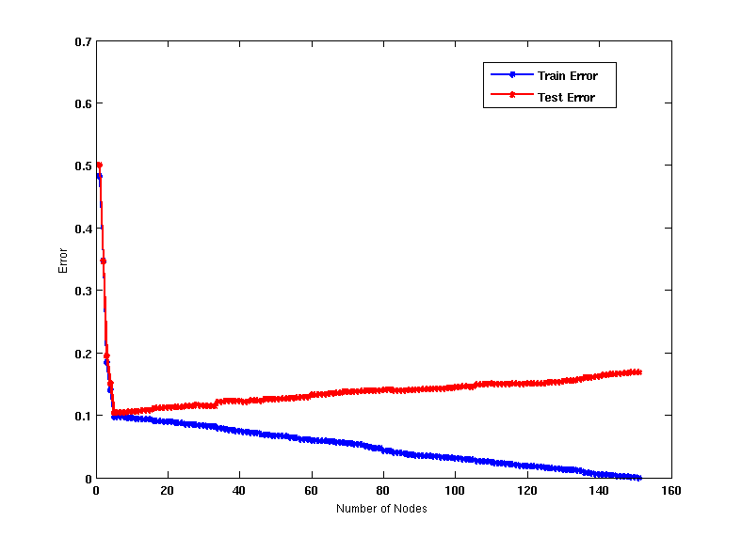
Model Underfitting and Overfitting
As the model becomes more and more complex, test errors can start increasing even though training error may be decreasing
NN size
Iterations in NN
DT size
Underfitting: when model is too simple, both training and test errors are large
Overfitting: when model is too complex, training error is small but test error is large

Slide 16
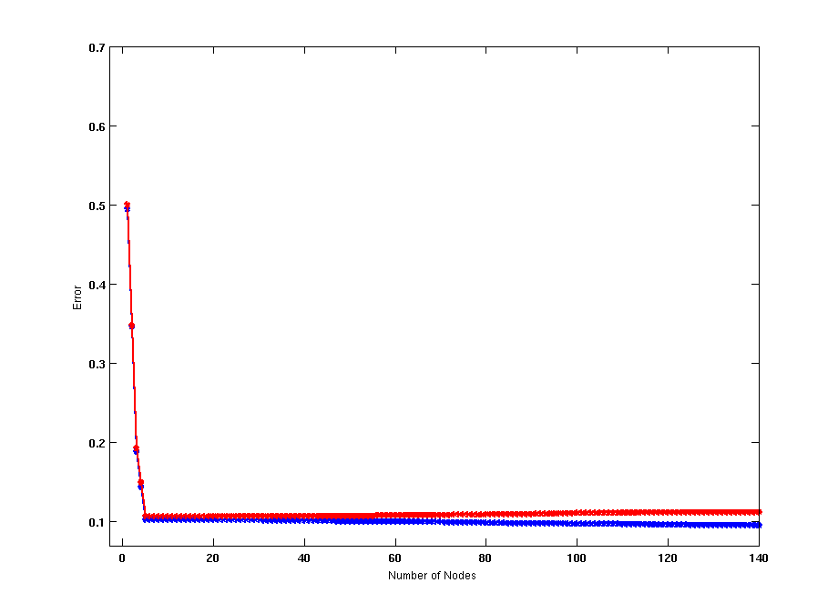
Model Overfitting – Impact of Training Data Size
Using twice the number of data instances
Increasing the size of training data reduces the difference between training and testing errors at a given size of model

Slide 17
Model Overfitting – Impact of Training Data Size
Decision Tree with 50 nodes
Decision Tree with 50 nodes
Using twice the number of data instances
Increasing the size of training data reduces the difference between training and testing errors at a given size of model

Slide 18
Reasons for Model Overfitting
Not enough training data
Over training (train NN with large number of iterations)

Slide 19
Model Selection
Performed during model building
Purpose is to ensure that model is not overly complex (to avoid overfitting)
Need to estimate generalization error
Using Validation Set
Incorporating Model Complexity

Slide 20
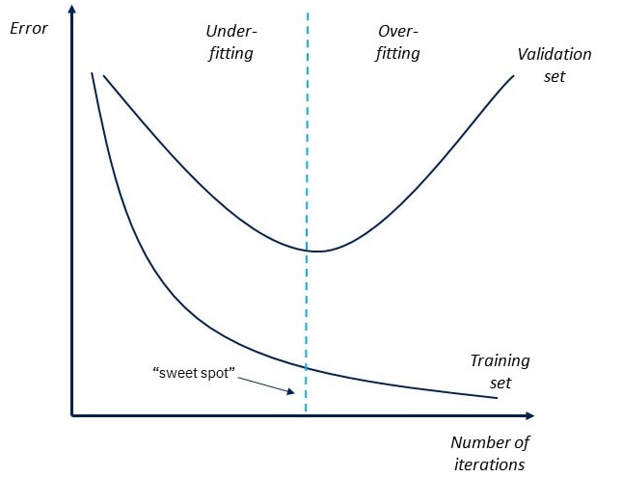

Slide 21
Model Selection: Using Validation Set
Divide training data into two parts:
Training set:
use for model building
Validation set:
use for estimating generalization error
Note: validation set is not the same as test set
Drawback:
Less data available for training

Slide 22
Model Evaluation
Purpose:
To estimate performance of classifier on previously unseen data (test set)
Holdout
Reserve k% for training and (100-k)% for testing
Random subsampling: repeated holdout
Cross validation
Partition data into k disjoint subsets
k-fold: train on k-1 partitions, test on the remaining one
Leave-one-out: k=n

Slide 23
Overfit and underfit for NN
Build 4 NNs
Tiny
Small
Medium
Large
Draw training & validation curves for the 4 networks

Slide 24
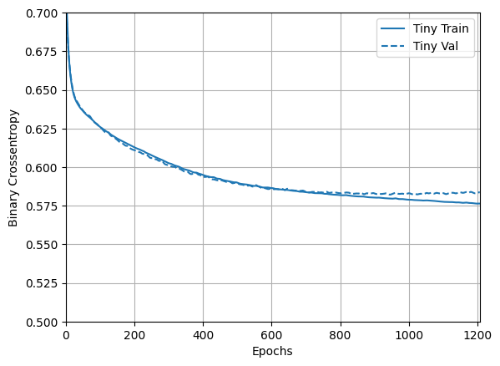

Slide 25
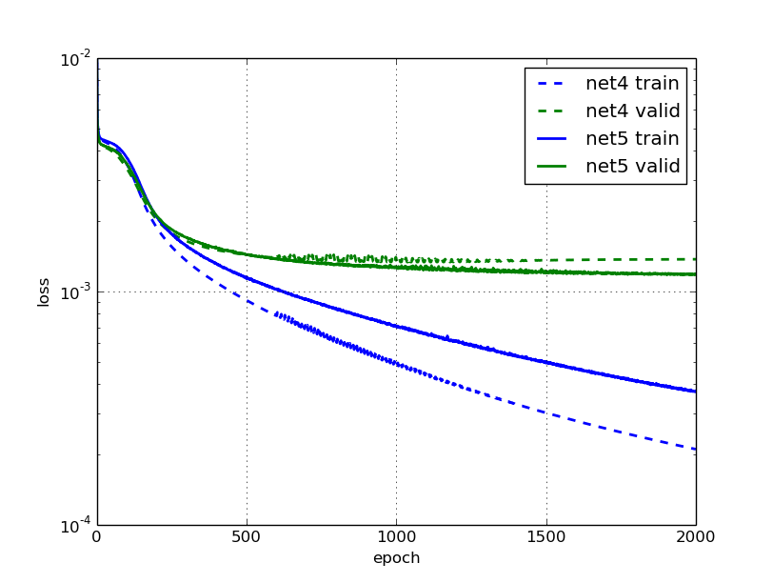

Slide 26
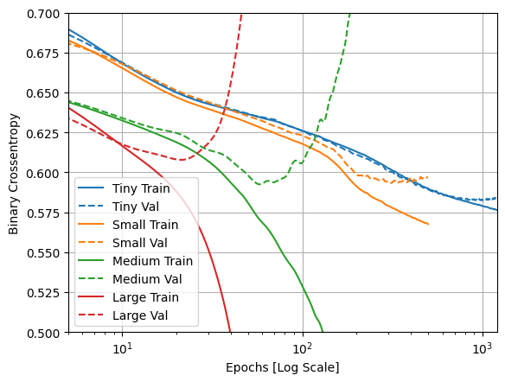


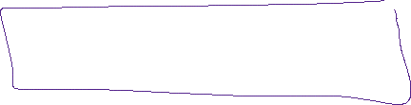


Slide 27
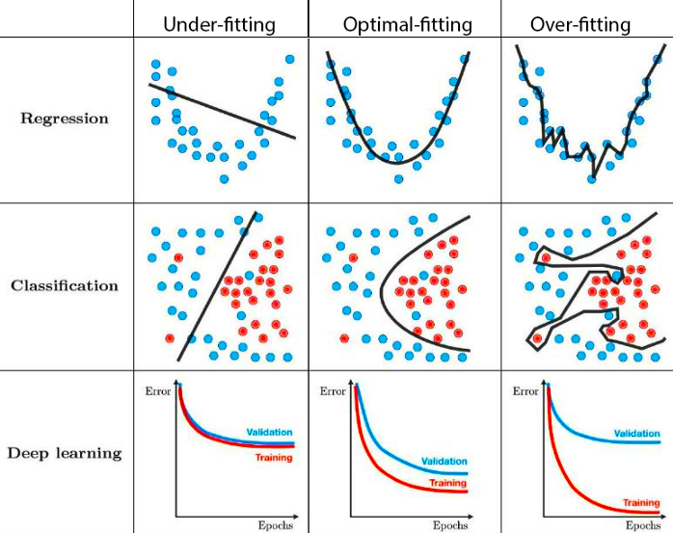





Slide 28
Two types of Evaluation
Classification Evaluation
Regression Evaluation

Slide 29
Classification Evaluation

Slide 30
Confusion Matrix
A confusion matrix shows the number of correct and incorrect predictions made by the classification model compared to the actual outcomes (target value) in the data.
The matrix is NxN, where N is the number of target values (classes).
Performance of such models is commonly evaluated using the data in the matrix.
The following table displays a 2x2 confusion matrix for two classes (Positive and Negative).

Slide 31
Confusion Matrix
Confusion Matrix |  | Target (Actual)
 |  | Positive | Negative
Model Prediction | Positive | a (correct) | b (incorrect) | Positive Predictive Value precision | a/(a+b)
 | Negative | c (incorrect) | d (correct) | Negative Predictive Value | d/(c+d)
 |  | Sensitivity recall | Specificity | Accuracy = (a+d)/(a+b+c+d)
 |  | a/(a+c) | d/(b+d)
Accuracy : the proportion of the total number of predictions that were correct.
Positive Predictive Value or Precision : the proportion of positive cases that were correctly identified.
Negative Predictive Value : the proportion of negative cases that were correctly identified.
Sensitivity or Recall : the proportion of actual positive cases which are correctly identified.
Specificity : the proportion of actual negative cases which are correctly identified.

Slide 32
Example
Confusion Matrix |  | Target
 |  | Positive | Negative
Model | Positive | 70 | 20 | Positive Predictive Value | 0.78
 | Negative | 30 | 80 | Negative Predictive Value | 0.73
 |  | Sensitivity | Specificity | Accuracy = 0.75
 |  | 0.70 | 0.80
N = # of instances = a + b + c + d = 70 + 20 + 30 + 80 = 200

Slide 33










Slide 34

Model Evaluation - Regression

Slide 35
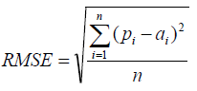
Model Evaluation - Regression
After building a number of different regression models, there is a wealth of criteria by which they can be evaluated and compared.
Root Mean Squared Error
RMSE is a popular formula to measure the error rate of a regression model. However, it can only be compared between models whose errors are measured in the same units.

Slide 36
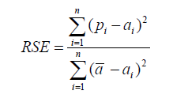
Model Evaluation - Regression
Relative Squared Error
Unlike RMSE, the relative squared error (RSE) can be compared between models whose errors are measured in the different units.

Slide 37
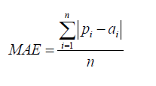
Model Evaluation - Regression
Mean Absolute Error
The mean absolute error (MAE) has the same unit as the original data, and it can only be compared between models whose errors are measured in the same units. It is usually similar in magnitude to RMSE, but slightly smaller.

Slide 38
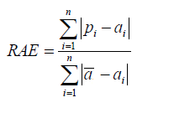
Model Evaluation - Regression
Relative Absolute Error
Like RSE , the relative absolute error (RAE) can be compared between models whose errors are measured in the different units.

